Slide 1
SNWA GOES DCS Report
By Chris Ashinhurst
Southern Nevada Water Authority

Slide 2
SNWA/LVVWD
LVVWD
  Municipal water provider for the city of Las Vegas.
SNWA
  Water purveyor for Southern Nevada
  Process and treat more than 400,000 ac-ft through treatment and return flow credits.
  Alternative water resources due to drought on CR.
    Spring Valley
    DDC Valleys

Slide 3
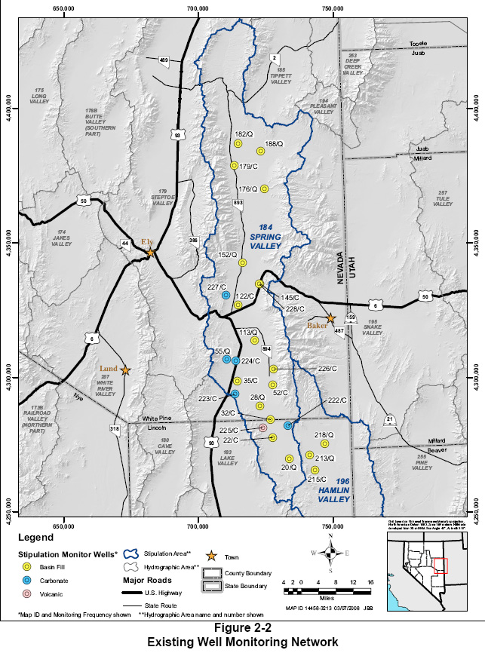

Slide 4
Stations
GOES Transmitters
  1x Surface Water
  2x Groundwater
Outstations (Transmitting data to GOES stations)
  1x Surface Water
  1x Groundwater
  2x Precipitation
Not Yet Transmitting (Possible Future)
  40+ Groundwater
  20+ Surface Water
  10+ Precipitation
Notes:
Using DAA equipment (Waterlog Xylem YSI)

Slide 5
Telemetry Equipment

Slide 6
Performance
Installed GOES transmitters initially Summer 2013
300 baud CS2
Generally very good. Only minimal data outages.
Issues
  User Error Generally
  Too much data
  Data logger clock settings.

Slide 7
Future Work
Irrigation Wells
  Flow
  Water Level
  Well head pressure.
Remote location wells for background water-level monitoring.

